Slide 1
雲端計算
Cloud Computing
Software as a Service

Slide 2
Agenda
Introduction
  New business model
  What is SaaS
SaaS: properties
  User and vendor view
  Cloud properties
SaaS: technique
  Service layer
  User interface
Case Study
  Salesforce.com
  eyeOS

Slide 3
Introduction
Service model
Definition

Slide 4

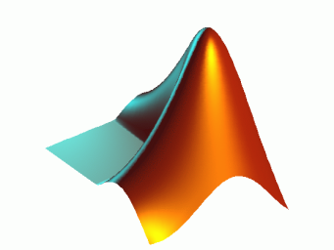
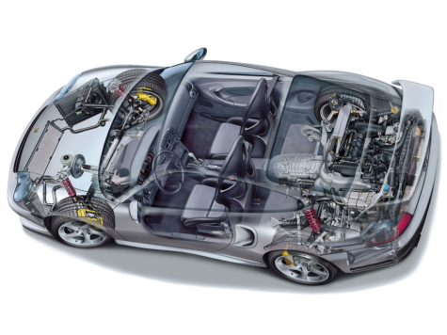
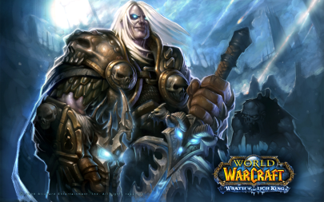
Software
In 21th century
  We may not want buy a software
    Instead, software can be billed by usage.
  A professional software is much expensive
    Someone may only need to use few times

Slide 5

How about rent?
Someone needs a software, but
  Use few times
  Have not much money
  Share with the company’s partner
  …
Can we rent a software?
  Decrease the TOC (total ownership cost)

Slide 6
ASP
Application service provider (ASP) is one of the choice
  ASP moves the applications to Internet
  ASP packaged software into a object that can be rented
The provider is responsible for maintaining the hardware and for managing the system
  Customers can focus on the usage
  Customers need not to worry about the system’s operation

Slide 7


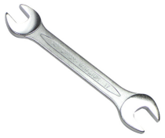



Example
E-mail service
  The provider hosts the mail service, manages the system and maintain the hardware
  The customer uses the service without buying the hardware and software license

Slide 8
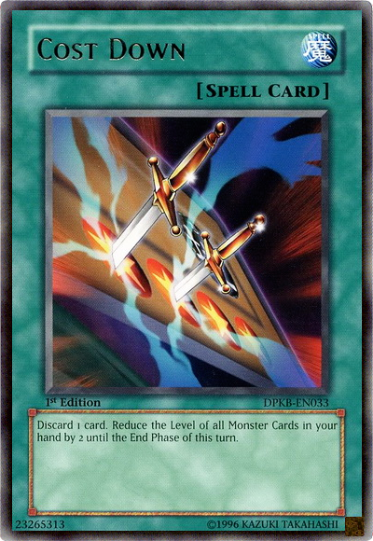
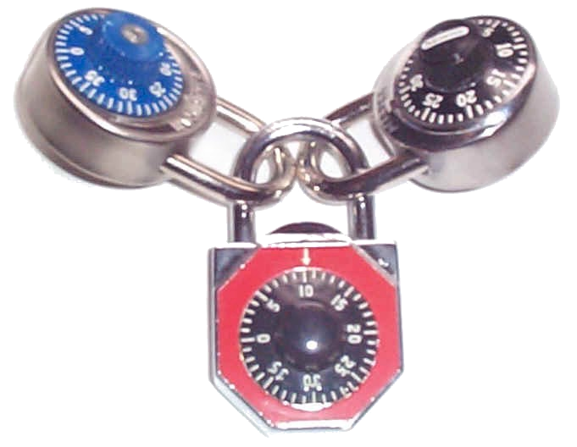
Benefit
Consumers can reduce
  Total ownership cost
  Requirement of IT personnel
  Maintain and upgrade
But there are some tradeoffs
  Lock-in
  Lengthy bid process
  Loss of fine tuning

Slide 9


Software as a Service
SaaS is another solution
  Not sold off
  Pay-as-you-go
  Interact between client and back-end platform
Compared
  ASP is a provider
  SaaS is a service model

Slide 10
Introduction
Service model
Definition

Slide 11
SaaS
Software as a Service (SaaS)
  delivering software as a service over the Internet
  eliminating the need to install
  simplifying maintenance and support
SaaS not only has the advantage of the ASP, but also has extra benefit
  Fit your requirement
  Increasing or decreasing resources on demand
  Easy to apply, easy to use and easy to leave

Slide 12
Definition
In general, SaaS can classify by the mode of delivery and system maturity
  Ad-hoc
  Configurable
  Multi-tenant
  Scalability and customized

Slide 13
Ad-hoc
The simplest architecture of SaaS
  The vendor provide many hardware which can install the software user need.
  Each customer has his own hosts and the applications run on these hosts.
  The hosts and applications is independence for each other.
  Customer can reduce the costs of hardware and administration.

Slide 14
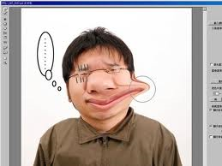
Configurable
The second level of SaaS which
  provides greater program flexibility through configurable metadata
  Provides many instance to difference users through detailed configuration
  Simplifies maintenance and updating of a common code base

Slide 15
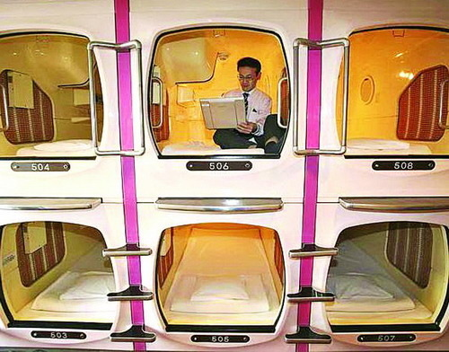
Multi-tenant
The third level of SaaS which
  Adds multi-tenant to the second level
  Provides a single program service to all customers by setting configuration
  More efficient use of server resource than level 2, but ultimately is limited in its scalability

Slide 16
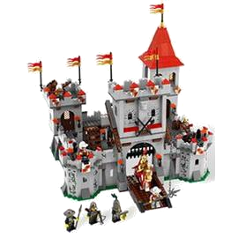
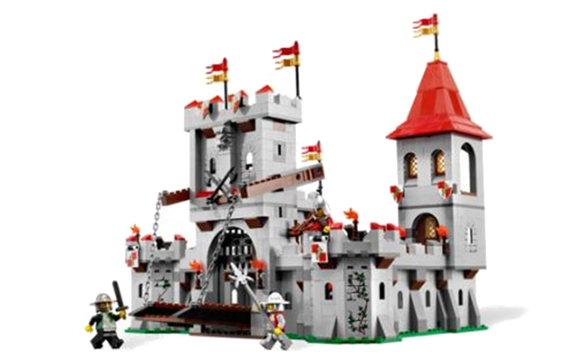
Scalability and Customized
The last level of SaaS
  SaaS adds the property of scalability and load-balance.
  The system’s capacity can increase or decrease to match demand.
  Customers uses the application on the SaaS is similar as on the local host.

Slide 17

So, SaaS is…
A service model that delivers software
  User believe that use the dedicated machine and his own operating environment.
  Vendor can deploy many kind of software version by changing the profile.
  Consumer meet the requirements with few extra setting.
  Vendor can service lots of users and wide range of their needs.

Slide 18
Properties
Benefit
Accessibility
Elasticity
Manageability
Reliability

Slide 19
Characteristic
SaaS is a new model of operation in the beginning
  Providing service platform that users can use applications or software.
In cloud computing, SaaS is one of three main service architecture
  Using the benefit of cloud computing, SaaS can supply more rich service on the web.

Slide 20
User view
Companies
  Low IT cost and management responsibility
  Short development time
  Pay-as-you-go
End users
  Low learning curve
    Familiar or intuitive interface
  Global access
    Work on anywhere and anytime

Slide 21
Vendor view
Integrate all IT and resource
  Provide a high-end service.
  Reduce procurement and operating costs.
  Maintain is easier, billing is easier
Economies of scale
  Winner-take-all
  Build it once, run it everywhere and charge monthly use fees.
Usually, one system to provide for them all.

Slide 22
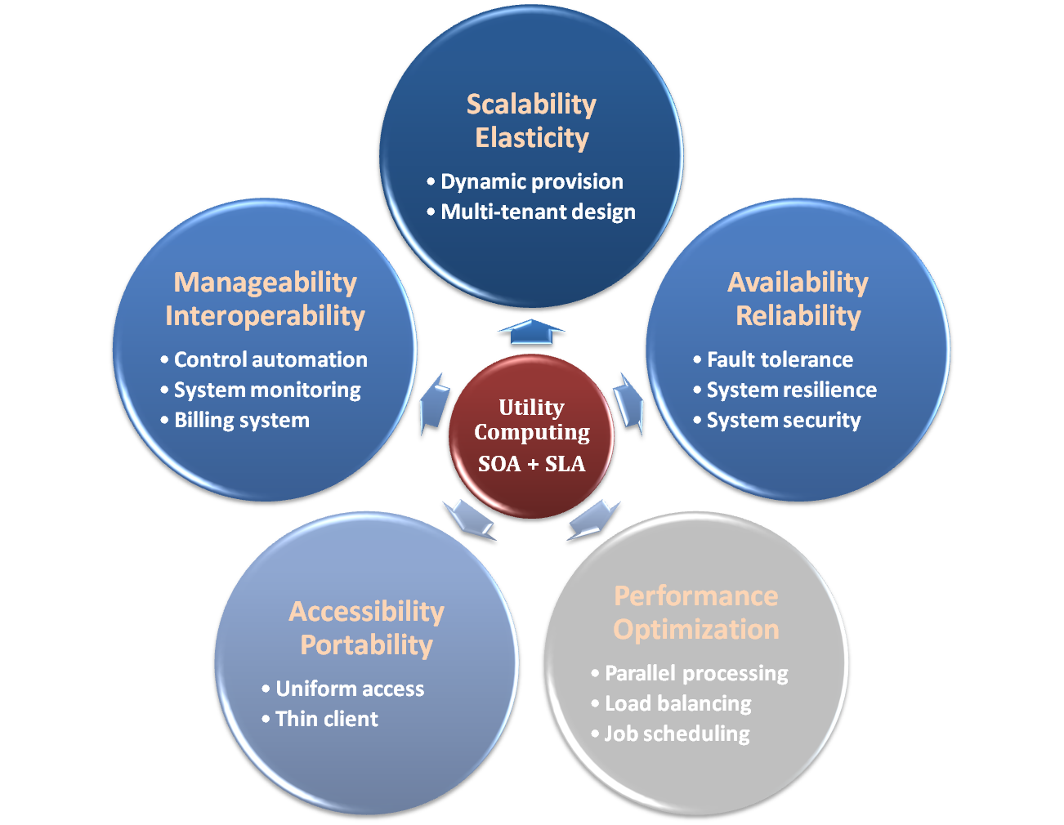
With Cloud
Accessibility
  Access service anywhere and anytime
Elasticity
  Service all consumers
Manageability
  Easy to be controlled, maintained and modified.
Reliability
  Access control and avoid the phishing web page.

Slide 23
Properties
Benefit
Accessibility
Elasticity
Manageability
Reliability

Slide 24
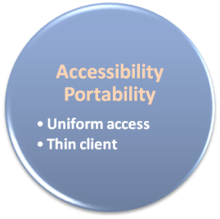
Accessibility
End user can access the service provided by vendor anywhere
  School or home with the Ethernet
  Bus or TRTC with wireless network or 3G
  Any environment which can connect to Internet
… and any platform
  Any OS, like Windows, Linux, Unix, Mac OS
  Any device, like desktop, notebook, smart phone

Slide 25
Cross Platform
Cross platform is one of the core concept on SaaS accessibility
Web Interface is one of solutions
  User access service in Internet without any application installing.
  Any browser gains the same result.
Java is other solution
  Applications can run on JVM without any extra setting

Slide 26
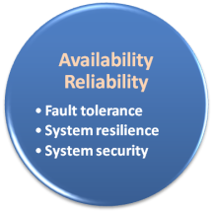
Accessibility vs Availability
Availability is focus on the system’s reliability
  System’s capable rate
  Mean time between failures (MTBF)
  Mean time to recovery (MTTR)
In the high availability system, usually uses nines to correspond the ratio
  99.9% means 8.67 hours of downtime per year
  99.999% means 315 seconds of downtime per year

Slide 27
Properties
Benefit
Accessibility
Elasticity
Manageability
Reliability

Slide 28
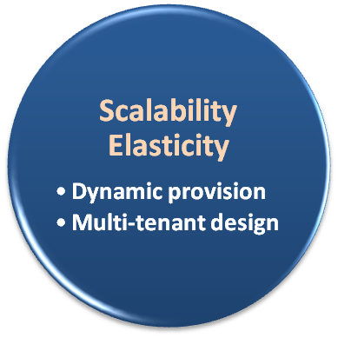
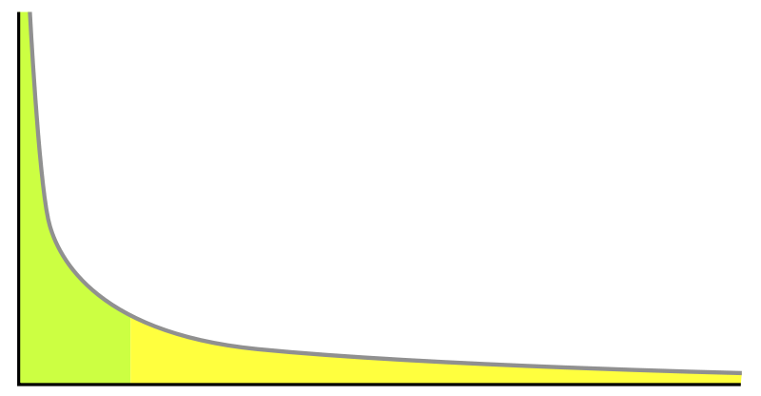
Long Tail
Most of users does not use all ability of computer
  Lots of computers are idle and waste the energy
But few users cannot meet their requirement when using the desktop
  Buying the professional server would also satisfy the long tail theory.
Computer ability
Desktop
20%
80%
Number of users

Slide 29

Multi-tenant
In cloud computing, number of users will not be limited to only few thousands
  Lots of users cloud use same application architecture with few personal profile.
  Re-build the hardware or re-deisgn software is waste and unrealistic
Instead, mass deployment with few metadata can reduce lots of time and money

Slide 30
Technique
Virtual machine that user run application on his independent system.
  Developed the basis system which can install personnel plug-in or package.
Dist partition or independent structure scheme that user store information and file in his independent storage space.
  All data store in the same storage device
  Each user can only access their data by application controlled.

Slide 31
Properties
Benefit
Accessibility
Elasticity
Manageability
Reliability

Slide 32
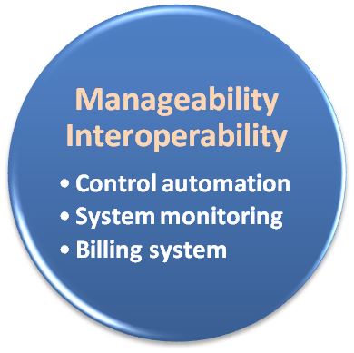
Centralization
Cloud computing collect all data and all computing capacity in one or few data center
  Centralized management, deploy and update
Consumer is not limited to local residents, instead, everyone can become a user of cloud computing service
  Low ability vendor supplied would decrease the user experience
  The distance of user and data center could large than hundreds to thousands of kilometers

Slide 33
Deployment and Consistent
Data centers would locate in the key cities
  Google has 19 locations in the US, 12 in Europe, one in Russia, one in South America and three in Asia
  User connect to nearest data center and reduce the connection latency
Redundant data center improves the reliability
  One of the data center down, user can access the other one, and user only fell a little delay.
  But vendor should be worry about the consistent between data centers

Slide 34
Benefit
Centralization management increases the efficiency of management
  Vendor can hire the professional IT staff
    E.g. IBM’s security chief or Steve Jobs.
  Data center can increate the security, like buying an expensive and professional firewall
  Any failure in data center can be repaired on time

Slide 35
Properties
Benefit
Accessibility
Elasticity
Manageability
Reliability

Slide 36
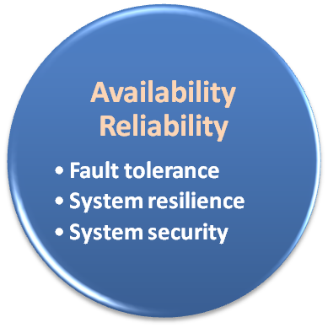
Security
SaaS provides a group of servie
  Most of services need to authenticate
  Service modules are integrated with each other
  Access level should be controlled
In user view
  Login repeatedly is annoying
  Avoid falling into the phishing website
In vendor view
  Carefully identify users
  Reduce security risks

Slide 37
Authentication
SaaS provides two kinds of authentication that handle different scenarios
Many services in the same vendor
  One authentication can access all of services in the same domain.
  Unified manage the account permissions
Many services in different vendors
  The impartial third-part responses the authentication
  Reduce the probability of collisions account

Slide 38
Advantage
User
  Avoid to remember lots of user account and password
  Avoid to fall into the phishing website
  Increase the security factor
Vendor
  Easy to manage the user’s privacy data.
  Reduce extra authentication center.
  Reduce legal liability.

Slide 39
Technique

Slide 40
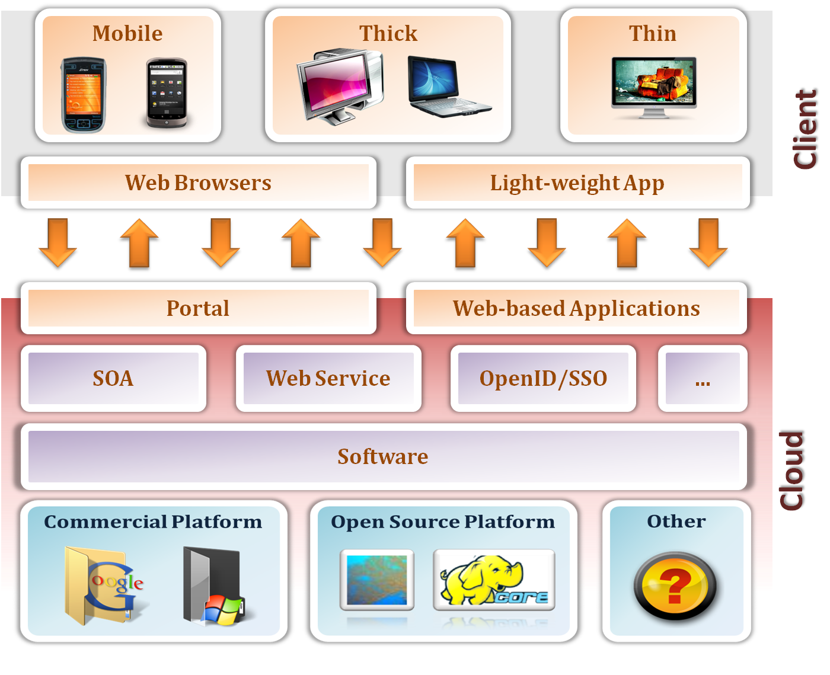
Overview
SaaS is a collection of lots of technology
  Platform
  Service layer
  User interface

Slide 41
Overview (cont.)
Platform
  Traditional or cloud platform that provides runtime environment
Service layer
  Communicates or integrates between services
  Provides SaaS properties
User interface
  Supplies an interesting and interactive interface
  Reduce the difficult to use
PaaS or IaaS

Slide 42
Service Layer

Slide 43
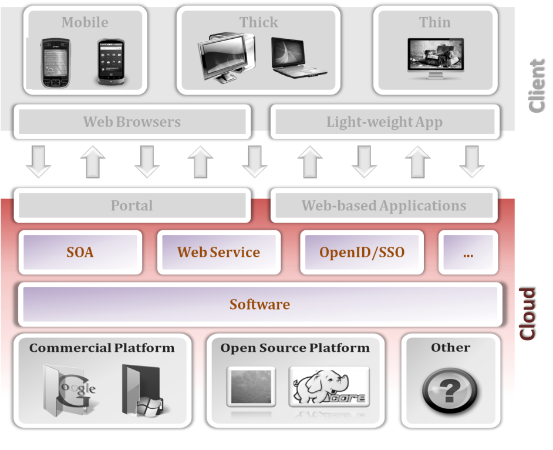
Service layer
Service layer provides many service concepts
  How to reduce the development time and cost?
  How to combine or integrate services and companies?
  How to handle the access control?
  …etc

Slide 44
Service Layer
SOA
Web Service
Other service: standard

Slide 45

Scenario
A company wants to design and develop a new web service
  There are many subprojects which could collaborate with each other.
  One or few members responses a subproject.
  Only few months of development time

Slide 46

SOA
SOA (Service-oriented architecture) is a concept that is used for reducing the cost of money, human resource and development time
  Reuse the completed services
  Open and standard interface
  Service abstract
  Loosely coupled
  …etc
service
service
service
service
service
service

Slide 47
Concept
Reuse each service
  Theoretically, each service can be reused every time.
  When designing a new project, just need to implement the new features.
Open and standard interface
  Using the same interface (like REST, SOAP, RPC…etc) can easier to integrate, communicate and cross platform.

Slide 48
Concept (cont.)
Service abstract
  User only need to know how to use.
  Hiding the redundant information, user can use service easily with few necessary data.
Loosely coupled
  One service module has little or no knowledge of the definitions of other module.
  Easy to update or patch without notifying other module.
Stateless
  Server needs not to recode the user’s status.
  User send request with status that would be more flexibility on using service.

Slide 49
Tradeoff
But overuse these concept would limit the usage of service
  Highly abstraction lead to service module cannot be used intuitively.
  Loosely coupled lead to need extra information used in communication.
  Stateless lead to send large extra data, it would decrease performance.

Slide 50
Service Layer
SOA
Web Service
Other service: standard

Slide 51
Scenario
Service modules may not in the same machine
  In the same rack.
  In the same cluster.
  …etc.
Communication between services is important
  Describe the service
  Deliver the service
  Publicize the service

Slide 52
Web service
Web service is a service that responses the users’ requests by
  Using Internet technique
  Crossing different platforms
  Interacting, integrating and communicating with other services.
The core concept of the web service
  Reuse the service
  Flexibility to integrate with other service

Slide 53
Web-based Service
Web-based service is a service provided by web interface
  May or may not interactive with other web sites.
  May or may not provide their service.
The benefit of web-based service
  Cross platform – you can access the service by the browser.
  Anywhere and anytime – in any place where you can connect to Internet.
≠Web Service

Slide 54
Why we need Web Service
Time
  The faster we provide service, the easier we get the money.
Cost
  Reusing the service can reduce the R&D costs.
Flexibility
  Integration of services can supply more comprehensive services.

Slide 55
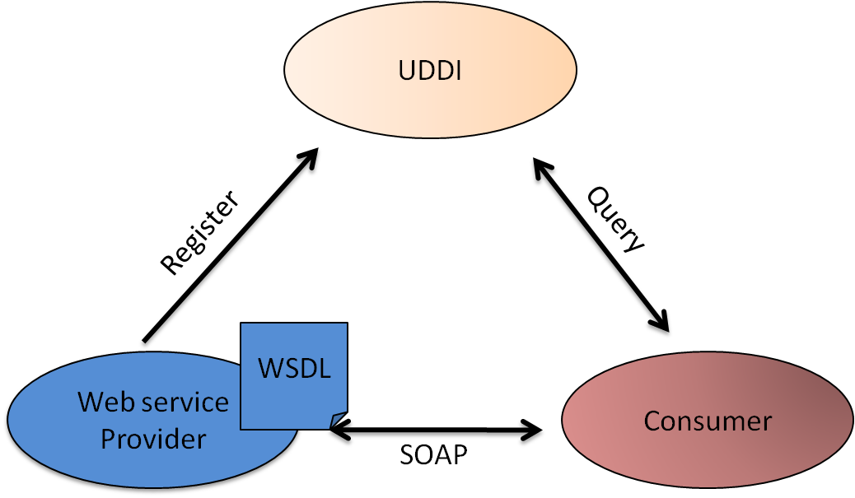
Triangle
Web service cloud be separate into three basic parts
  WSDL
    The description of web service, include the service name, functionality, company’s name, using method…etc.
  SOAP
    The method used to exchange messages between two nodes.
  UDDI
    A register center which can collection, integration and discovery web service.

Slide 56
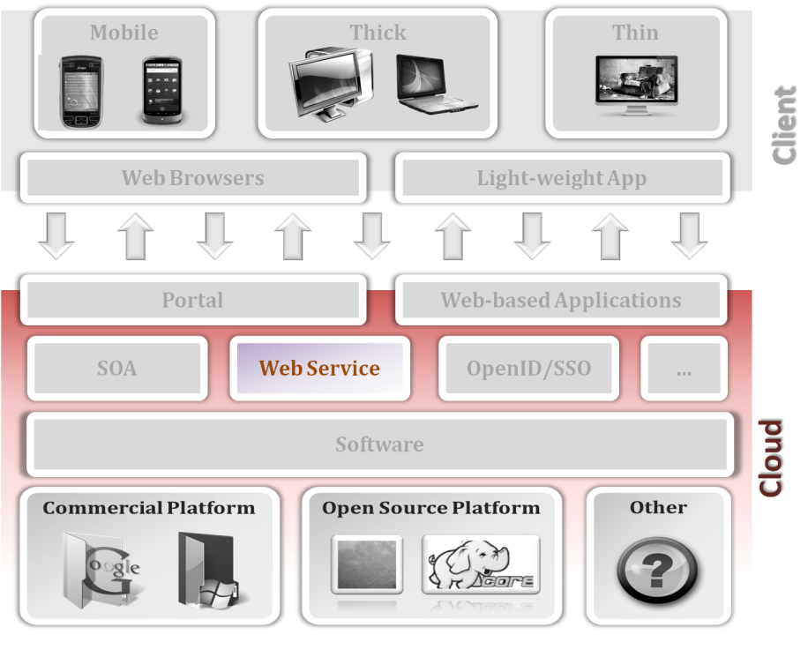
Web service
WSDL
SOAP
UDDI

Slide 57
WSDL
Web service distribution language (WSDL) is an XML file that distributes the web service, include
  service information
  abstractive operations
  communication types
  other information that can improve the effective of exchange the service.
The host can know the web service by analysis the WSDL file.

Slide 58
Property
WSDL has four advantage on exchange the web service information
  Service abstract
  Cross platform
  Automatic
  Remote

Slide 59
Property (cont.)
Service abstract
  User can access the service without knowing the service’s operation logic.
  Providers can update or patch service without notifying the user.
Cross platform
  WSDL uses the XML file to distribute service which can be used in any platform.
  XML is independent on platform, OS and programming language.

Slide 60
Property (cont.)
Automatic
  There are many tools can generate or decode the XML file.
  Reduce the cost and human resource on producing the WSDL file.
Remote
  By connecting to Internet and getting the correct mode of operation, user can access and call the service anywhere and anytime.

Slide 61
Four elements
WSDL has four basic elements for distributing the service
  Type
    data structure of web service information.
  Message
    the parameter of exchanging message.
  Binding
    The network protocol using on communication.
  PortType
    the request/response type on communication.

Slide 62
PortType
One-Way
  Service receives message only.
  The operation has a single input element.
Request-Response
  The service receives a request message and send a response.
Solicit-Response
  The service sends a message and receives a response.
Notification
  The service sends message only

Slide 63
Web service
WSDL
SOAP
UDDI

Slide 64

SOAP
Simple Object Access Protocol (SOAP) is a communication protocol based on XML
  By HTTP or other network protocol
  Exchanging web services’ information
  Connecting to other web services

Slide 65
Core concepts
The core concepts of SOAP are simple and extendable
  To achieve these two concepts, SOAP omits the message framework of
    Reliability, security, correlation, routing … etc.
  Instead, put these functionality into the extensibility module.
The SOAP can be a lightweight protocol and has more flexibility.

Slide 66
Three basic module
The message framework can be classify into three module
  Processing module
  Underlying module
  Message construct
And more, SOAP has a extensibility module which can add capability found in richer messaging environments.

Slide 67

Process Module
Processing module
  This module defines the method of processing message
  Message can pass through any numbers of intermediaries from sender to receiver.
  Support many types of message exchange patterns
  Each message is processed independent
    This means SOAP does not recode message’s state
intermediaries
Sender
Terminal receiver

Slide 68
Underlying Module
This module distributes the protocol used in SOAP.
  Can be carried within or on top of variety of other protocols.
The boundary between SOAP and the underlying protocol is called a binding, and there are two purposes
  Passing an outgoing message of sending that message to another SOAP node.
  Passing an incoming message of processing that message.

Slide 69
Message Construct
The SOAP message is specified as an XML infoset which is used in exchange message between two SOAP nodes.
The SOAP message includes
  Commands
  Attributes
  Namespace

Slide 70
Web service
WSDL
SOAP
UDDI

Slide 71
UDDI
UDDI (Universal Description, Discovery, and Integration) is a cross-platform service which
  Based on XML.
  A register server.
  Can find the service you need.
  Can post your service.
  Can exchange your service to another company.

Slide 72
Why need UDDI
In the world
  We cannot reach to anywhere.
  We cannot find the service directly.
  We cannot sell service to each person in the world.
In the Internet
  Network links everyone in the Internet.
  Internet has no geographical boundaries.

Slide 73
Three pages
White page
  Give information about the service, include name and the description of the business, which may support multiple languages.
Yellow page
  Provide a classification of service of business based on the standard taxonomies.
Green page
  Describe how to access the Web service, include the url, API and protocol.

Slide 74
Example: UDDI
A company wants to post his web service
  Find a register center
  Design and upload their WSDL file and SOAP protocol
  Wait until customer connect to and use their service.
…but he need some help
  Search the service from UDDI register center
  Find the service by some key-word
  Connect to the particular web service by the WSDL file and SOAP protocol.

Slide 75





Example: Web Service
Register server
WSDL
WSDL
Register his server
Search the vendor
I need flowers
Transaction
Sell his service: flowers

Slide 76
Service Layer
SOA
Web Service
Other service: standard

Slide 77
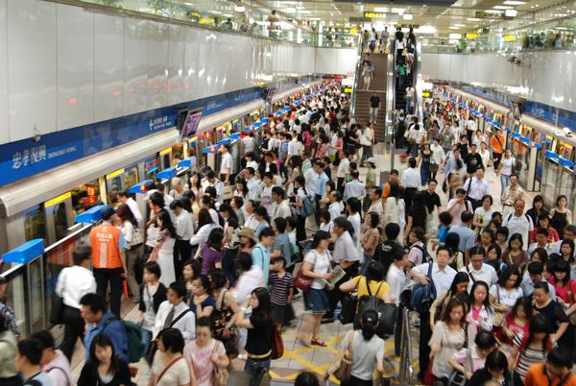
When scale up…
Web service provides a new way to use the service and cooperate with other companies, but
  When the users scale up, service cannot work at smooth as before.
  When service scale up, company re-development a new service.

Slide 78
Solutions
In SaaS, cloud provides a non-limitation environment that can serve users as many as possible.
But service could be re-development many times
  There are many services in Internet
  Develop a new service is costly and risky
Company should concentrate on the valuable service, not a duplication of development.

Slide 79
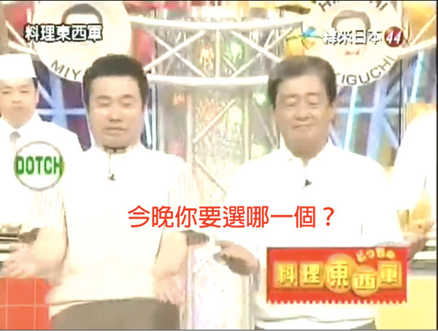
Suggestions
There are many suggestions for this problem
  Re-use the service
  Easy than SOAP to connect to services
  Reduce the complexity to use services
  A quantitative standard of services

Slide 80
Standards
OpenID and SSO
SLA
REST

Slide 81

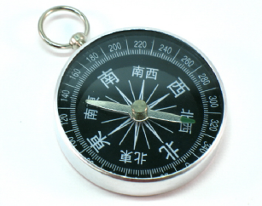
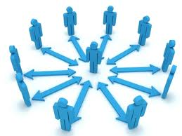
Scenario
There are many service in Internet
  Email, blog, social network, web game …etc
  Many service require user authentication
These will produce two kinds of problems
  Too many ID/password pair to should be remembered.
  Use same password in the imprudent site is not secure.

Slide 82
OpenID
OpenID is a new identify authentication system
  A open standard that users can be authenticated in a decentralized manner
  User can authenticate many service sites by only one username and password
  Account management is responsible to the trust company.

Slide 83
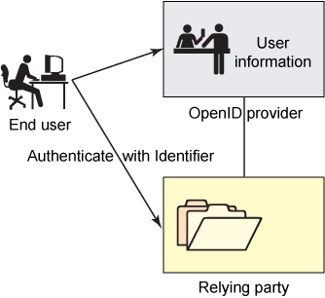
Architecture
End user
  Show the legal identity
Consumer
  Relying party
Identity provider
  Authentication server

Slide 84
SSO
SSO (Single Sign-On) is another authentication method
  Used in the same domain site or service provider which want to use many services
SSO can increate the security level
  Reduce the phishing success
  Avoid the re-entry the ID and password
  Exit system one time to keep security when user leave their computer.

Slide 85
Standards
OpenID and SSO
SLA
REST

Slide 86





Scenario
A multinational wants to rent a web service
  How to choice the provider?
  What level of service provider can provide?
  How to measure the service quality?
The service is interruption or cannot meet the requirement
  How to claim the damages or loss?

Slide 87
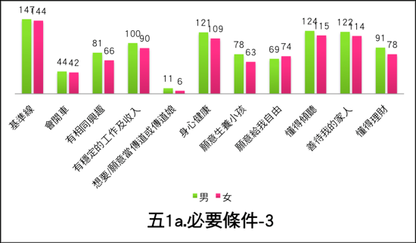
SLA
SLA (Service Level Agreement) is a part of contract that classify the service level
  Service reliability
  Performance, include bandwidth, I/O speed, CPU …etc
  Average downtime
Consumer can choice the service provider by SLA

Slide 88
Contract terms
Contract terms
  QoS (Quality of Servic)
    computing power, storage size, CPU speed.
  Management and maintain
  Mean time between failures, mean time between response, and error rate
Refund or compensation
  Below the guaranteed quality of service
    ≦99% refund 10% application billing or give some extra quota
    ≦90% refund 100% application billing

Slide 89
Standards
OpenID and SSO
SLA
REST

Slide 90
HTTP and REST
HTTP (HyperText Transfer Protocol) is a widely used protocol in the Internet
  The foundation of data communication for the WWW
  An the application layer
  HTTP can build on any communication layer (not only TCP), like SSDP (Simple Service Discovery Protocol)
REST is the three implement methods of Web Service
  Compared with SOA and XML-RPC, REST is more concise.

Slide 91
Three components
REST has three basic elements for communications
  Verbs - what’s you wants
    Get image, put username and password, …etc.
  Nouns - the target to provide service
    www.google.com/ or http://www.youtube.com/watch? , …etc
  Content – the information or something service needs or response
    Image, video, something required.

Slide 92
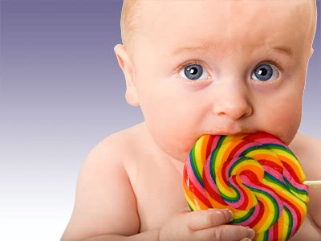
Three components (cont.)
I want my daddy’s candy
Want
My daddy
Candy
Maybe eat, play or just hold
Someone give her a candy
Lollipop, chocolate …etc

Slide 93
Benefit
Stateless
  There are no states in REST serve- side, instead
  User’s request with states can help server parallel processing request.
  Moreover, REST can cache popular data easier.
  Service can work normal when server updates or patch without notifying users.
Client device
  The browser is the client, reduce the software requirements.

Slide 94
User interface

Slide 95
User experience
User experience (UX) is about how a person feel about using a product or service.
  Highlights the experiential, affective, meaningful and valuable aspects.
  Include a person’s perceptions, like utility, easy of using and efficiency of system.
Consider the following scenario
  Open a web page or click a button
  Watch the MV on YouTube

Slide 96
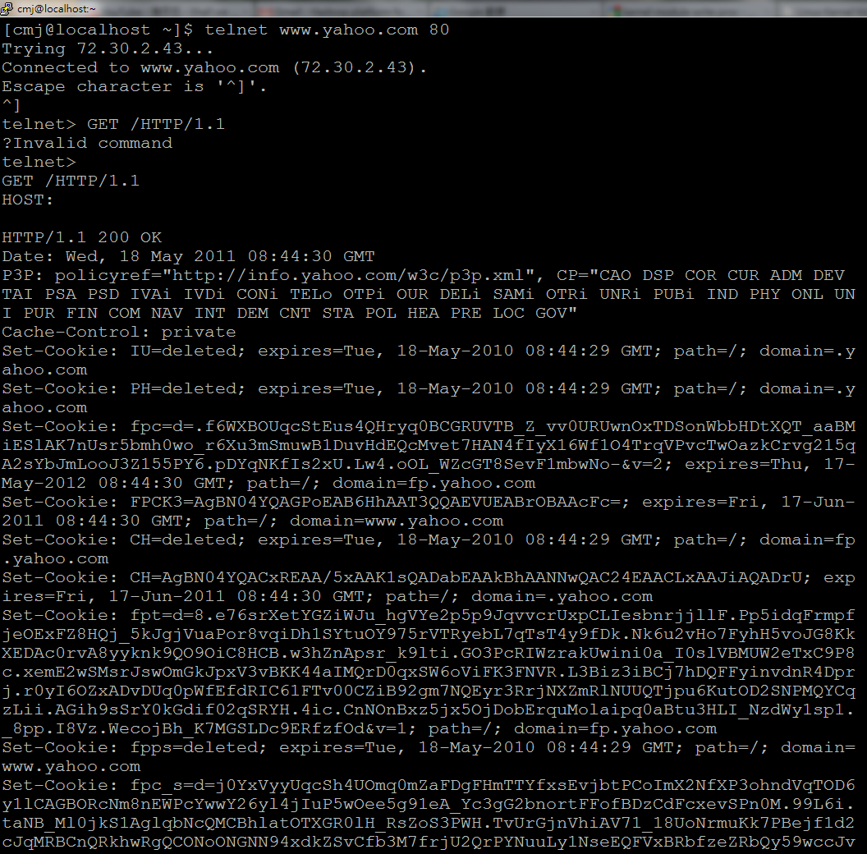
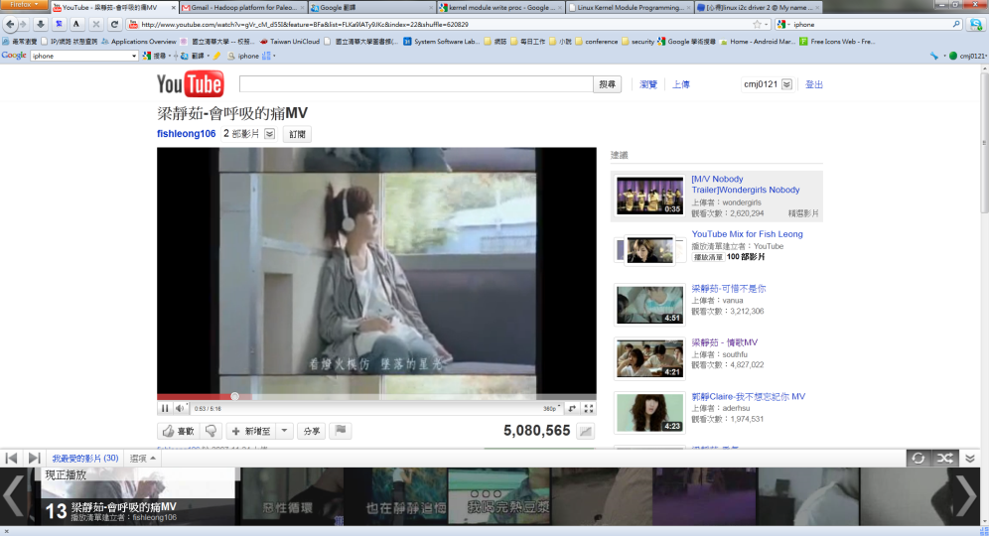
Access model
On the other hand, how to supply the service is also important in UX
  Command line
  Pure text or static image page?
  Or interactive interface with video?

Slide 97
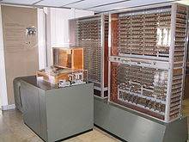
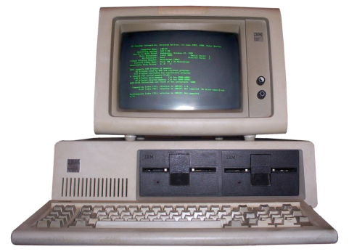
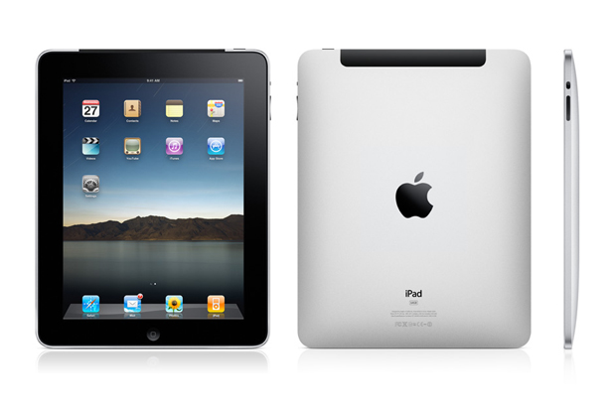
Device
And more, device also affect the UX
  How about the Zuse Z3, the first working programmable computer machine?
  How about the IBM PC 5150?
  Or the iPad?

Slide 98
User interface
Web Technique
Client Device

Slide 99
Web
Browser is the important media of Internet service
  Use browser to read or watch news, gossiping, videos or something you interesting.
  Communicate with friends or make new friends in Internet.
Websites supply many things, like text, image or video, to users
  How to provide things users like?
  How to attract the user’s attention?

Slide 100
Access model
User interface most affect the user’s feel
  Terminal is the original interface, and user afraid to use it.
  Graph user interface (GUI) is more friendly to user, but it is hard to cross platform.
  Web-based interface (WUI) is a subclass of GUI, and most of all computer has browser.
  Touch-screen is the newest display model, user can control the monitor without keyboard and mouse.

Slide 101
Web-based Interface
Web-based interface is most popular in recent years
  Web 1.0 gives users a new feeling, and change the user’s behavior of using computer.
  But web 1.0 provide static information, like image and text, that cannot meet the needs of current users.
  Web 2.0 is a group of new technique that can interact with users.
  Web 2.0 provides social network, web-games and more rich web service to users.

Slide 102
WUI (cont.)
Web 2.0 integrates many new technique
  Two-way message protocol, like XMLHttp, is used to communicate between users and sites without reload full web page.
  JavaScript provides rich and vivid interface that improves user experience
  Service-oriented architecture (SOA). Web application expose its functionality so that other can leverage and integrate this service.

Slide 103
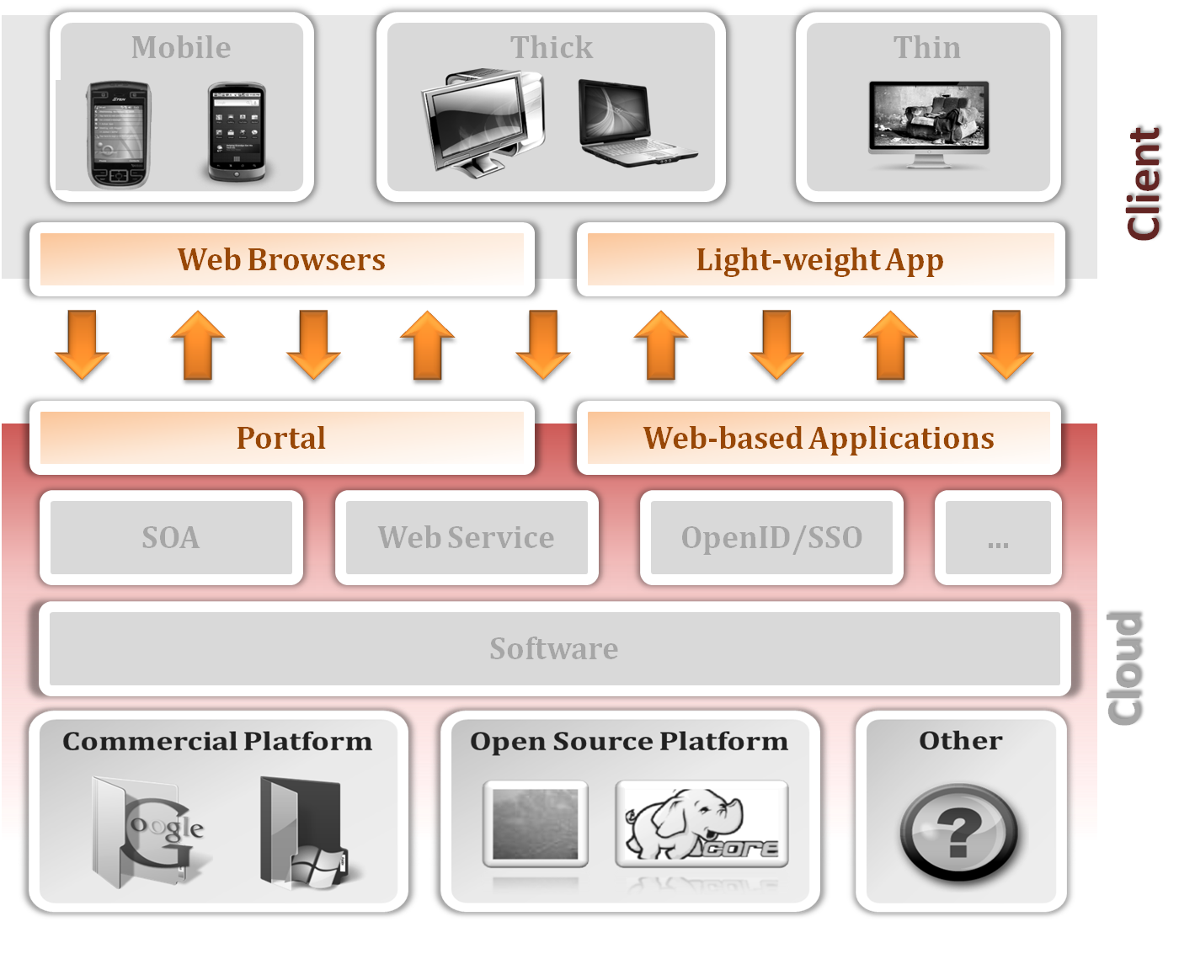
Web technique
Web 2.0
Application

Slide 104
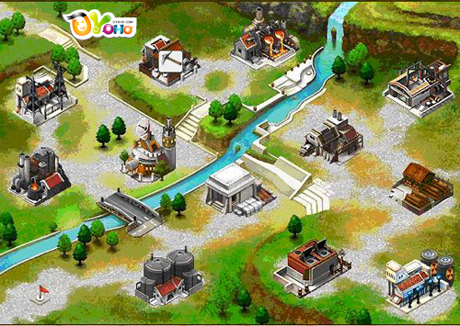
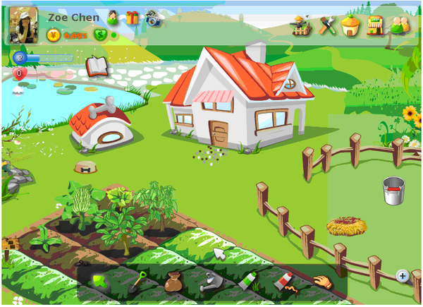
Interactive
In Web 2.0, web sites or web applications supply more interesting interface and functionality to users
  Web games
  Social networking sites
  …etc
The important element of success
  Interact with other users on the world

Slide 105
Ajax
Ajax (Asynchronous JavaScript and XML) is the technique that achieve the interaction between human
  Ajax is not a single technique, instead, is a group of technique include
    JavasSript
    CSS
    Dom (document object model)
    XMLHTTPRequest
    …etc

Slide 106
Ajax (cont.)
Basically, web 2.0 is constructed on the web 1.0
  Basic HTTP protocol, like hyperlinks, images or text
JavaScript is the widely used in the form of client-side
  Supply the rich and interactive interface
…and contains the CSS (Cascading Style Sheets) that
  Separate the construction and views
  Increase the readability of the original file
  Can be customized

Slide 107
DOM
DOM is a standard interface to process the XML files
  Can store the XML in the memory that can delete, modify and rearrange immediately
  Like cache, server can improve the performance
  But all of data, include the useless node and information, would also store into memory that waste the time and space.

Slide 108
XMLHTTPRequest
In the begin, user need to get a new web page only re-flush the web page
  Waste time
  Could be slow down the server performance
XMLHTTPRequest is the library of JavaScript, VBScript or else used in browser
  Send or receive XML and message between web server and browser
  Dynamically change or update the web pages without any plug-in or re-flush all web page

Slide 109
Web technique
Web 2.0
Application

Slide 110
Application
Traditional application
  Download to local computer
  Install or decompression
  Concerned about the compatibility of the system
  Concerned about the storage space and memory size
  Uninstall when no longer in use
Download
Install
Compatibility
Uninstall
Performance

Slide 111
Web Application
Web application
  Link to web sites
  Try it
  Close the browser
Compared with traditional application, web application is
  More simple and convenience
  Reduce the cost of storage space
  Need not to update
  Cross-platform

Slide 112
Drawbacks
Browser
  If the browser cannot support the functionality, applications would not work normally
  In general, web applications cannot work off-line
Application
  Most of web applications are not open source and cannot customized easily
  Entirely dependent on vendor
    Stop service when vendor close down
  Company can search any data or behavior of users

Slide 113
WebOS
WebOS is a group of web applications that run as a operating system in Internet
  Like web application, but more powerful
  Provides many applications
    Like notepad, music player …etc
  Without a physical storage
    instead, all data and application are in the server side

Slide 114
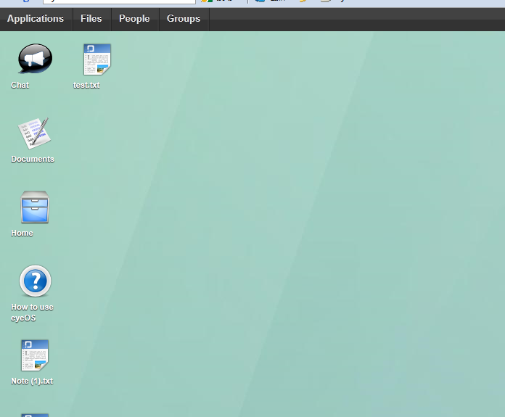
eyeOS
eyeOS is a open-source browser based web desktop
  Based on LAMP
  Work like a normal OS and simple to use
    Just like use web application
  Reduce the cost
    A device with Internet access
    A browser

Slide 115
User Interface
Web Technique
Client Device

Slide 116
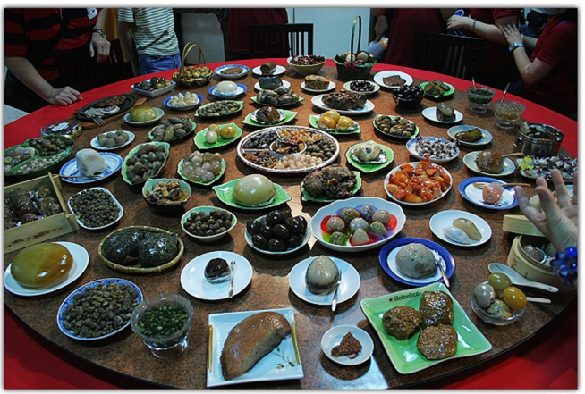


Client device
Client devices also affect user experience
  The client device is expensive or cheap?
  The client device is heavy or light?
  The client device is useful or redundant?
Precisely, what kind of devices we need?

Slide 117
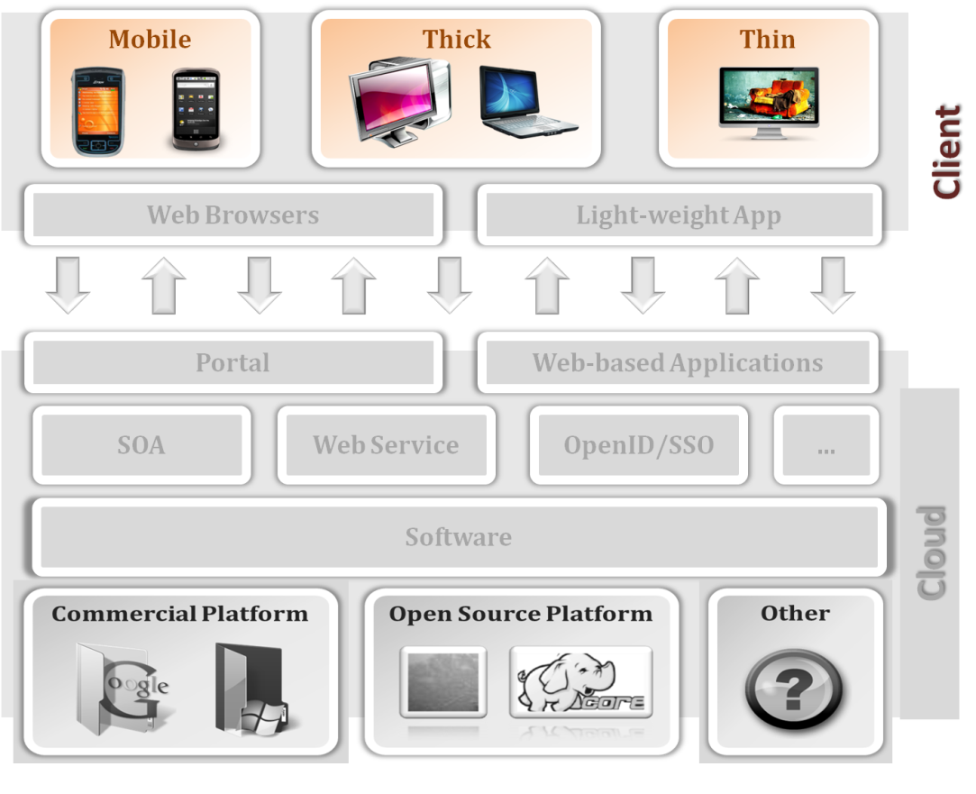
Client device
Thin client andThick client
Mobile device

Slide 118
Thin client
If user care the price of the device or the usage of time
  Keep the core functionality and necessary interface
    Reduce the hardware and design cost.
    Reduce the energy usage.
    Reduce the management and maintain loading.
  remove hard disk, heavy OS …etc.
    Only reserve a monitor, I/O interface, communication interface and flash memory or CD-ROM.

Slide 119
Benefit
Management
  Remove the mechanical movable devices, like HDD or CD-ROM, can reduce the ratio of failure
  Lots of data would not store in the client
Cost
  It would reduce the total cost without HDD, CD-ROM and high performance CPU
  Removed the extra hardware, it is low energy consumption.

Slide 120
vs Thick Client
Thick clients, also call heavy clients, are full-featured computers
  Compared with thin client that loss full functionality without a network connection, thick can provide a fully functionality.
  Compared with thin client, thick client is more heavy and complexity that would be used carefully.
Both of two are used in many scenario
  Need to compute complexity jobs
  Need to work in everywhere

Slide 121
Client device
Thin client andThick client
Mobile device

Slide 122
Mobile device
Focus on the size of device and easy to use
  Wifi is popular and widely used in the campus and commercial district
  Users may want to visit the website on the crowded bus to find the nearest restaurant.
Different with desktop, user use mobile device for increasing efficiency that
  Sending and receiving e-mail.
  Finding the road map.
  …etc.

Slide 123
Movable and Simple
Unlike the laptop, user need a handheld device that can easy used and portable
  Small enough that can handheld and put into the pocket
  Lightweight enough that not be a burden
  Simple enough that can easy use and control
There are two popular of mobile device
  PDA
  Smart phone

Slide 124
PDA
PDA (personal digital assistant) is a device that functions as a personal information manager
  A touchscreen for entering data
  A memory card for data storage
  Wifi and Bluetooth for Internet or exchanging data
PDA also can use to
  Browse the web
  Display multimedia
  Play game
  GPS navigator

Slide 125
Smart Phone
A smart phone is a phone that contain a open operating system
  Can install third-part applications
  Can be customized system without waiting patch
Smart phone is now the popular mobile device
  Compared with PDA, smart phone combines the ability of phone and computer
  And more, smart phone can download the rich third-part applications, like games, weather or traffic information, news…etc.

Slide 126
Case Study

Slide 127
Salesforce
Salesforce is one of the popular SaaS service vendor
  An enterprise cloud computing company.
  Hosting the applications offsite.
  The CRM (Customer Relationship Management) is the well-known product.
Salesforce provides many solutions on CRM
  Pay the rent per month
  Consumer can focus on the business, rather than stuck in the development environment.

Slide 128
Service model
Company cloud not buy and maintain the expensive hardware and software license, instead,
  Rent the hardware and software that reduce the cost.
  Use the service on Internet
  Run the business applications, like CRM, HR, accounting, which are stable and reliable
  Collaborate with each other
    User can receive message immediately and friendly, like Facebook or twitter

Slide 129
Services
Sales cloud
  Supply faster and optimize of all sales stages.
  Business model and bid analysis.
Chatter cloud
  Exchange daily information by chatter without email or network disk.
  Shared files and project states.
  Track personnel, information and group.
Force.com
  An environment allows external developers to create add-on applications
    HR application, inventory Application , IPhone or Android applications

Slide 130
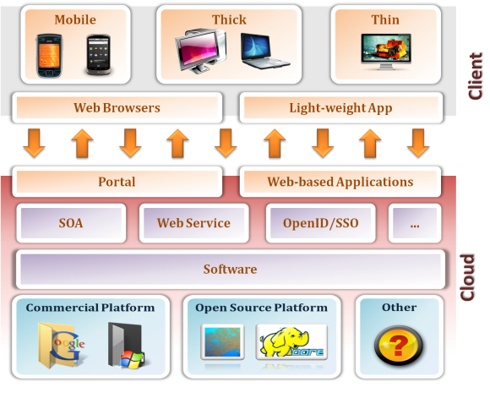
Summary
SaaS is not a single technique nor a new term
  A group of old and new techniques
    Server, platform, communication, interface and client device
  The server and platform can use the cloud technique or traditional
  Communication methods have to consider the cross-platform and multi-user environment
  Interface needs to simple and easy used
  User device and interface affect the UX

Slide 131
Reference
Web sites
  SaaS http://en.wikipedia.org/wiki/Software_as_a_service#Key_characteristics
  Salesforce http://www.salesforce.com/tw/
  WSDL http://www.w3.org/TR/wsdl20/
  SOAP http://www.w3.org/TR/2007/REC-soap12-part1-20070427/#intro
  OpenID http://openid.net/

